Slide 1



A Comparison of Space Telescope Configurations
Maggie Kautz, Dr. Rongguang Liang, College of Optical Sciences
with special thanks to the University of Arizona, NASA, and the Arizona Space Grant Consortium
NASA Space Grant Symposium
Sheraton Phoenix Airport Hotel Tempe, AZ
April 22nd, 2017

Slide 2
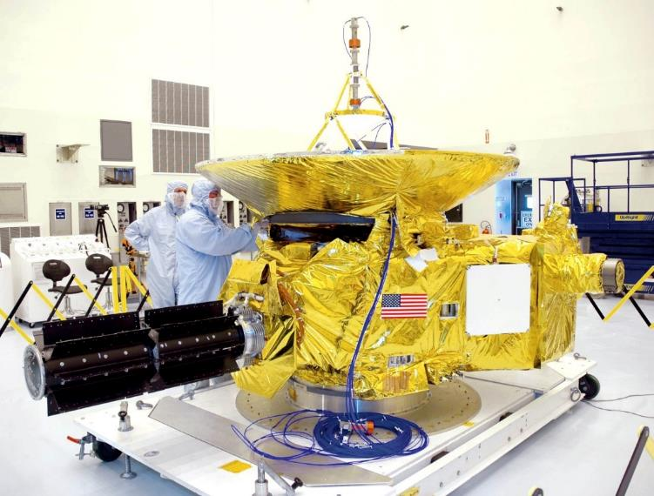
Why is this important?
Interest in space optical systems
Numerous designs meet different needs
  How can we most effectively meet these needs?
New Horizons

Slide 3
Various Configurations of Reflecting Telescopes

Slide 4
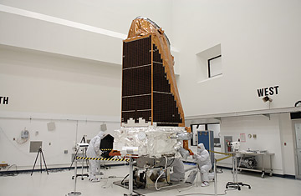
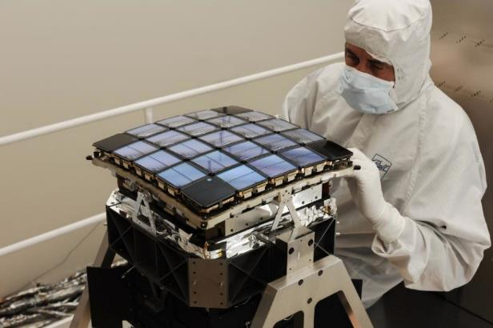
Kepler
Schmidt Configuration
Operates in visible wavelengths
Simplified configuration with one
mirror
Large FOV ≈ 12 degrees

Slide 5
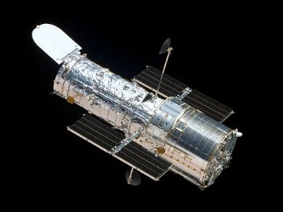
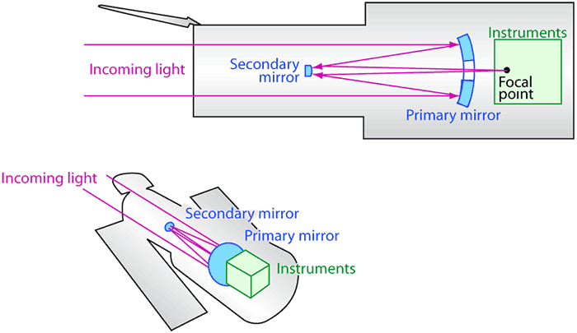
Hubble Space Telescope
Ritchey–Chrétien Cassegrain
Spherical aberration
Instruments:
  ACS: Advanced Camera for Surveys
  COS: Cosmic Origins Spectrograph
  FGS: The Fine Guidance Sensors
  WFC3: Wide Field Camera 3

Slide 6
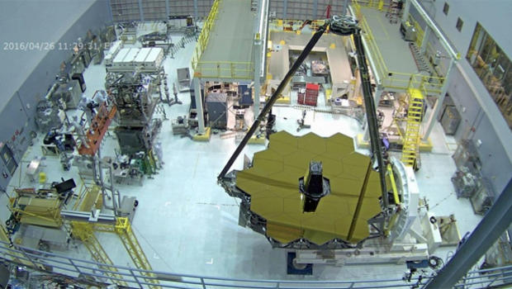
James Webb Space Telescope – the next generation after Hubble
Infrared space telescope
18 mirrors make up primary mirror
  Will unfold after launch
Cassegrain

Slide 7
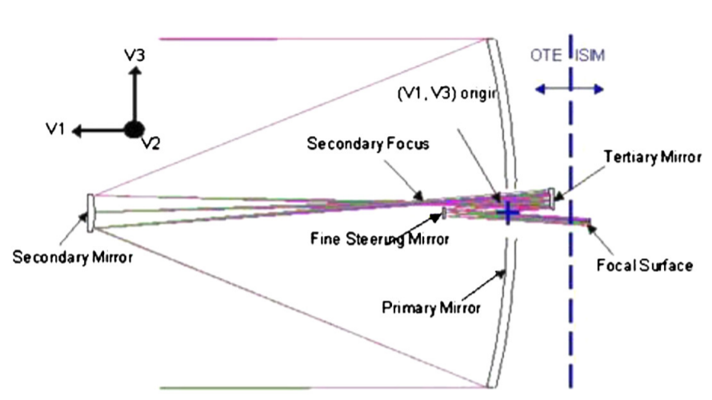
What makes the JWST better?
High resolution
Large FOV
Beryllium → strong, light
Gold mirror coatings

Slide 8
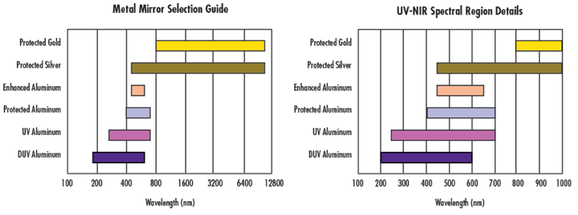
Mirror Coatings

Slide 9
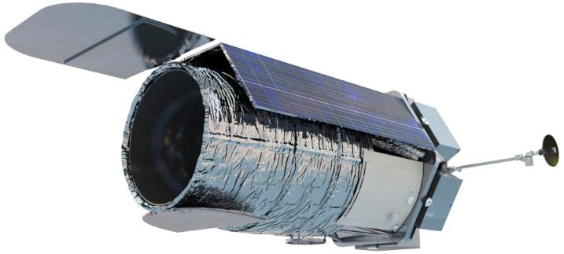
WFIRST
Still in design stage
Operates in the infrared
FOV 100x that of Hubble
Cassegrain + Three-mirror anastigmat

Slide 10
Thank you

